Slide 1
Next Generation Teaching and Learning
Charles Severance
Sakai PMC Chair
LongSight, Inc.
University of Michigan

Slide 2

Mission
Build a set of standards-based tool kits to greatly advance the state of the art of interoperability, reusability, and re-mixability for learning content and software.

Slide 3
What to Build
API Libraries – PHP, Java, Python, Ruby ...
App Store for Learning Applications
Content Store
Learning Management Systems (many)

Slide 4


Based on Standards
IMS Common Cartridge – 1.0, 1.1, 1.2, 1.3, 2.0
IMS Learning Tools Interoperability 1.0, 1.1, 2.0, 2.1, 2.2
IMS LTI Content Item - Public Draft
IMS LTI Roster Services – WG Draft
IMS LTI Outcomes Services – in WG Draft
IMS Caliper 1.0
IMS OneRoster – Rest-based SIS integration
IMS CASA – WG – Draft
IMS CC / EPUB 3.0 Coordination

Slide 5
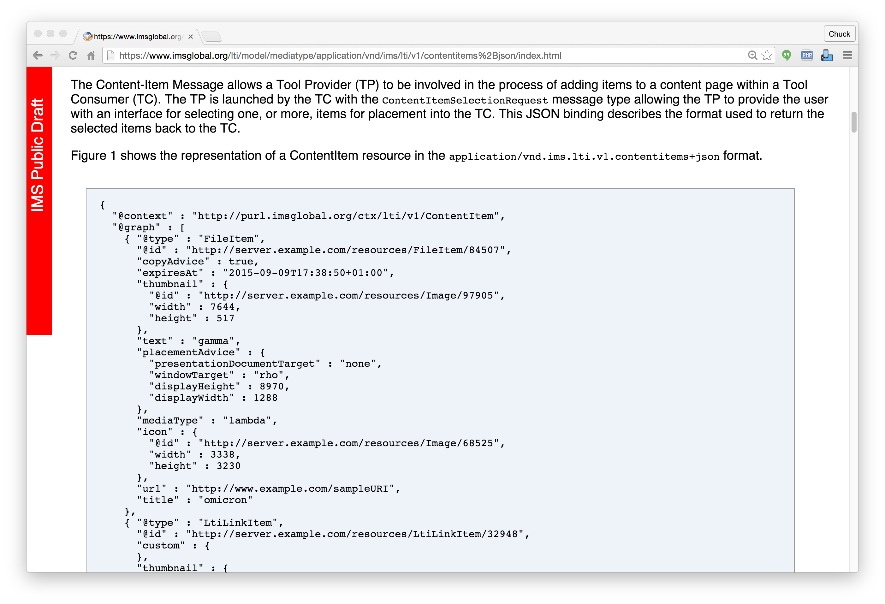
IMS
Content
Item
https://www.imsglobal.org/specs/lticiv1p0

Slide 6

IMS Content Item Launch
APP
LMS
Launch Picker
APP
APP
Launch Picker
Content
Repository

Slide 7
IMS Content Item Return
APP
LMS
APP
APP
APP
URL, Configuration
Content
Repository
IMS Common
Cartridge (ZIP File)

Slide 8
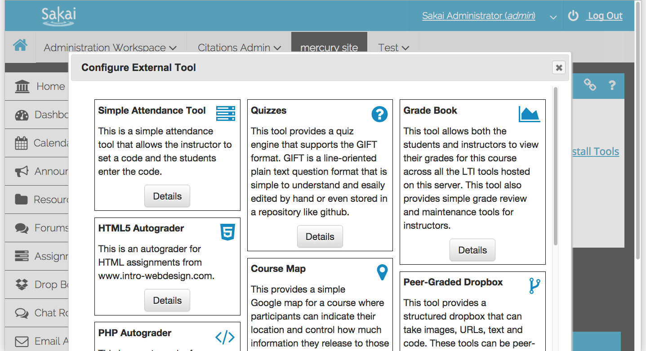
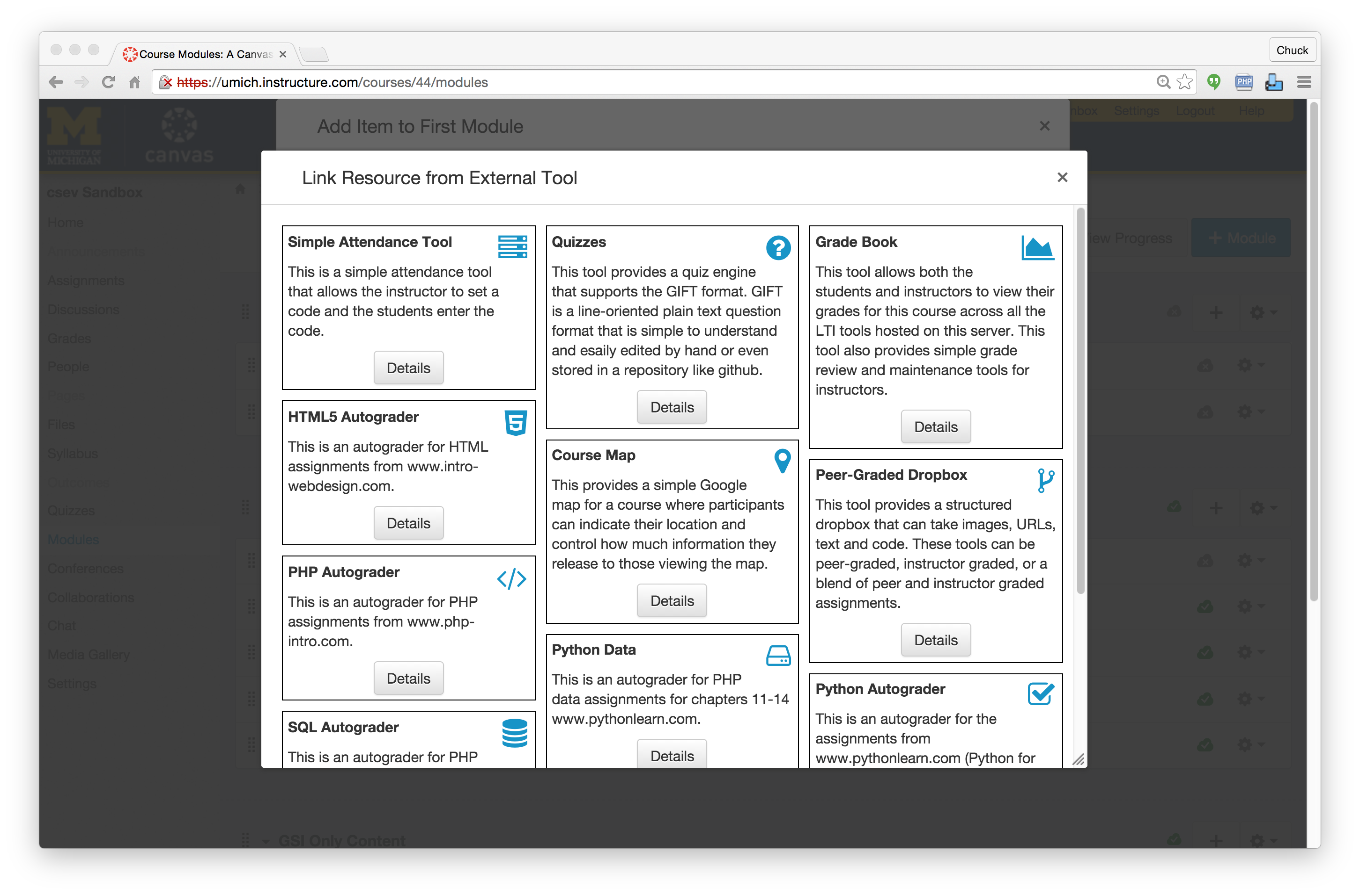

Slide 10
Standards Score Card
LMS | LTI 1.x | Content Item | LTI 2.x
Canvas | A | A | B+
Sakai | A | A- | A-
Moodle | A | B | B
D2L | A
Blackboard | A

Slide 11
Next Generation Teaching and Learning
The "post-LMS"

Slide 12
Tenets of the NGTL Movement
NGTL LMSs will be small with few features
They will scale from hundreds of students to millions
Content repositories will be plentiful
Will have better powerful authoring tools than LMSs
Most features come from app stores (also plentiful)
It will scale from hundreds to millions of users
There will be whole new customers and revenue flows
Students
Teachers

Slide 13
LMS/UI
LMS API Provider
APP
APP
LMS/UI
APP
APP
APP
APP/UI
Content
Repository
APP/UI
APP/UI
LMS/UI

Slide 14
Early Exemplars In The Space
Repositories
Blackboard xpLor
Canvas Commons
App Store:
Canvas EduAppCenter
ELMS Network – Drupal + LTI Provider
Tsugi – www.tsugi.org
Small LMS + App Store + Marketed t to Teacher
Edmodo – App Store not LTI
Schoology – App Store with LTI

Slide 15
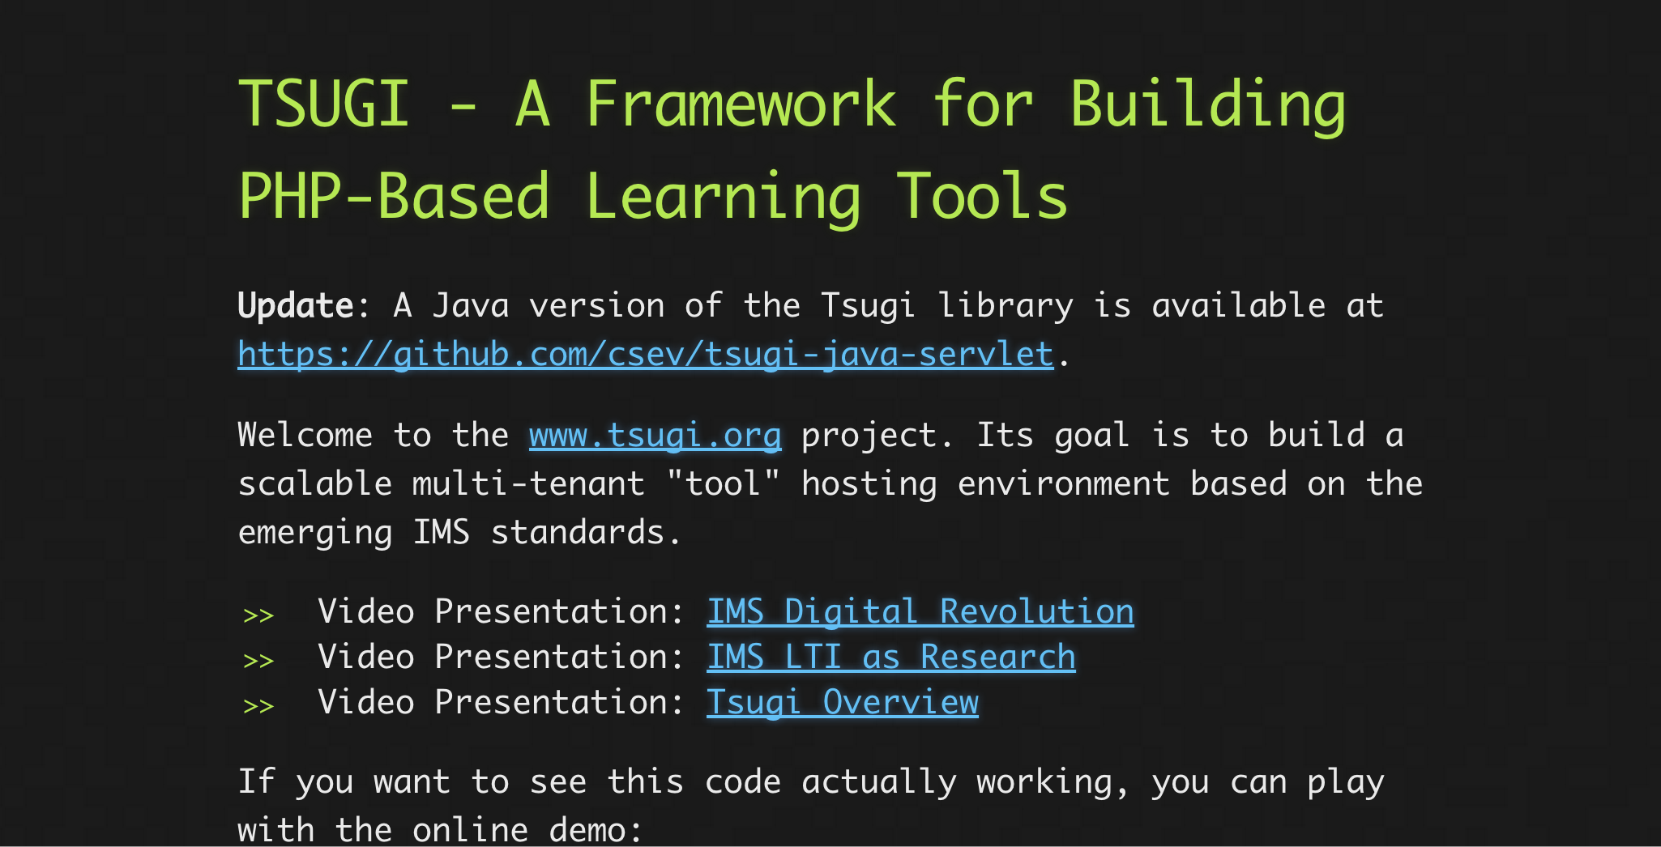
www.tsugi.org

Slide 16
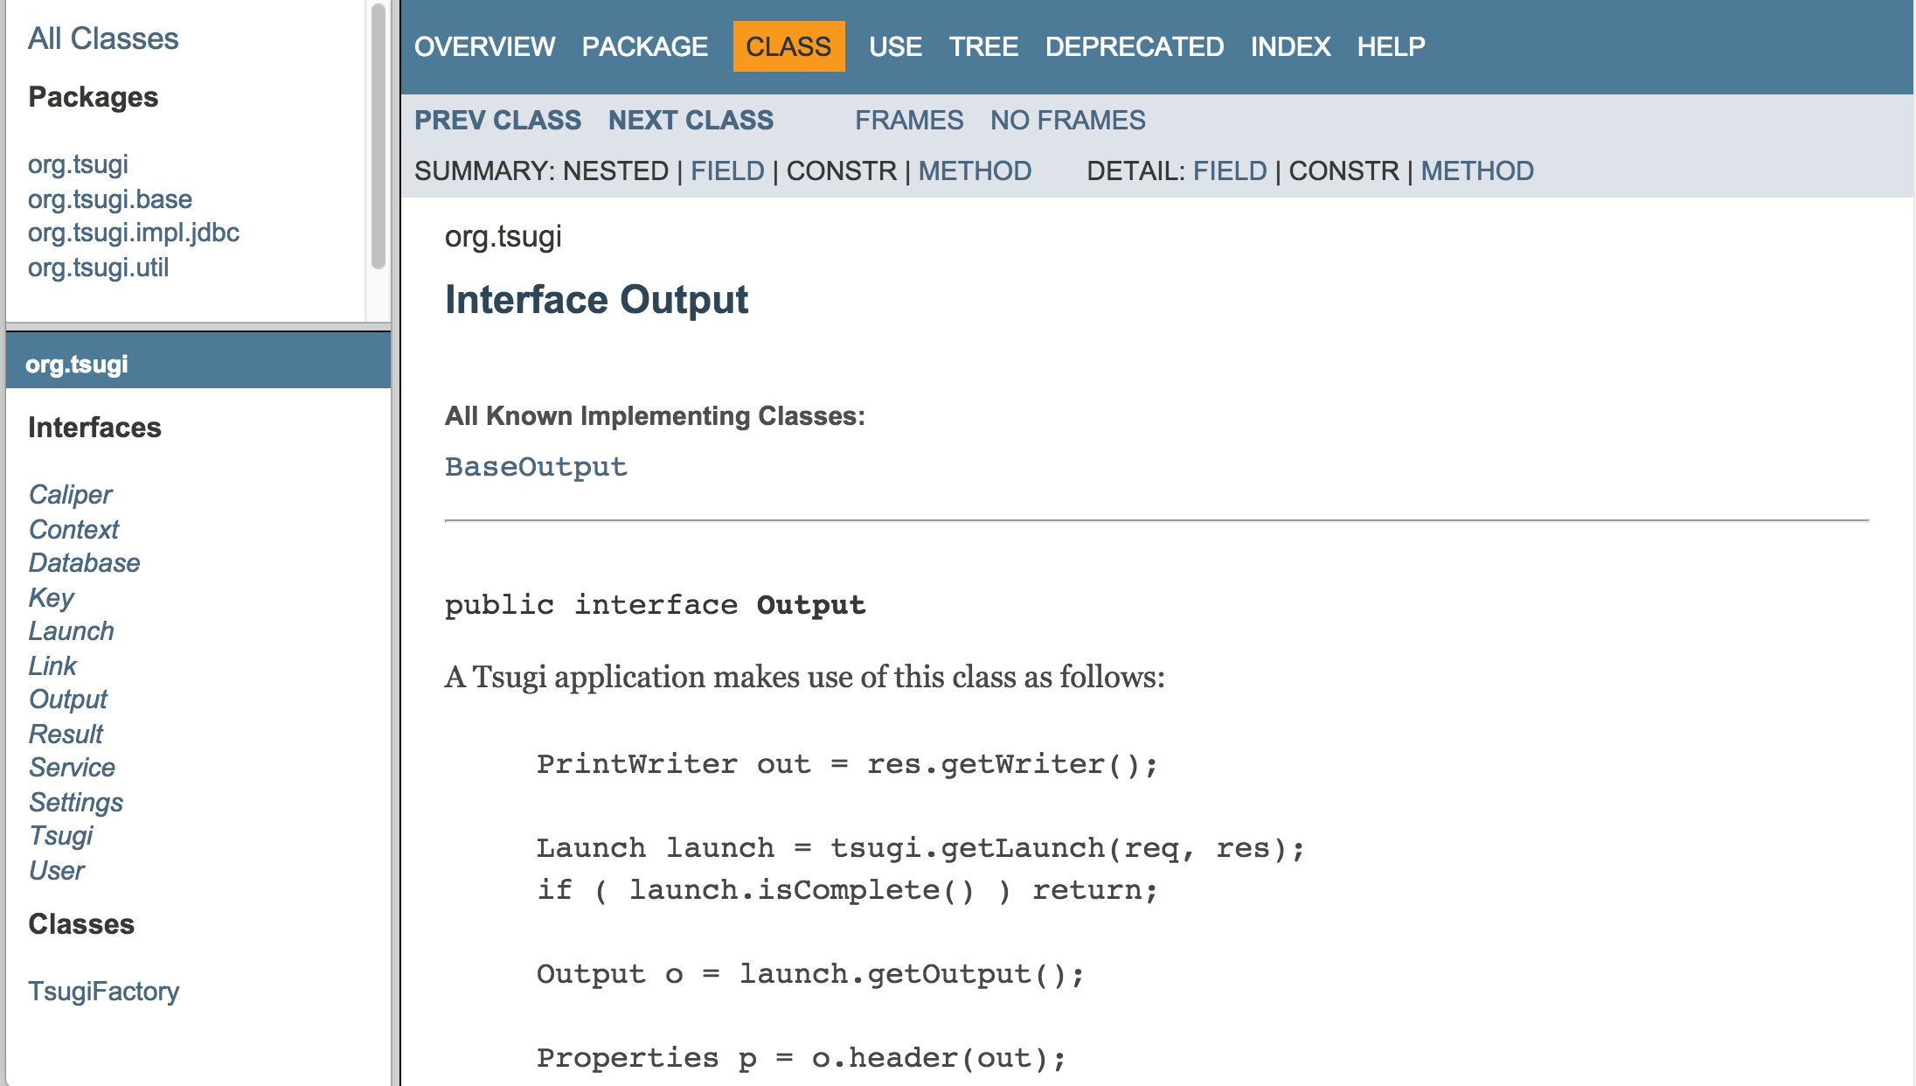
http://csev.github.io/tsugi-java/apidocs/index.html

Slide 17
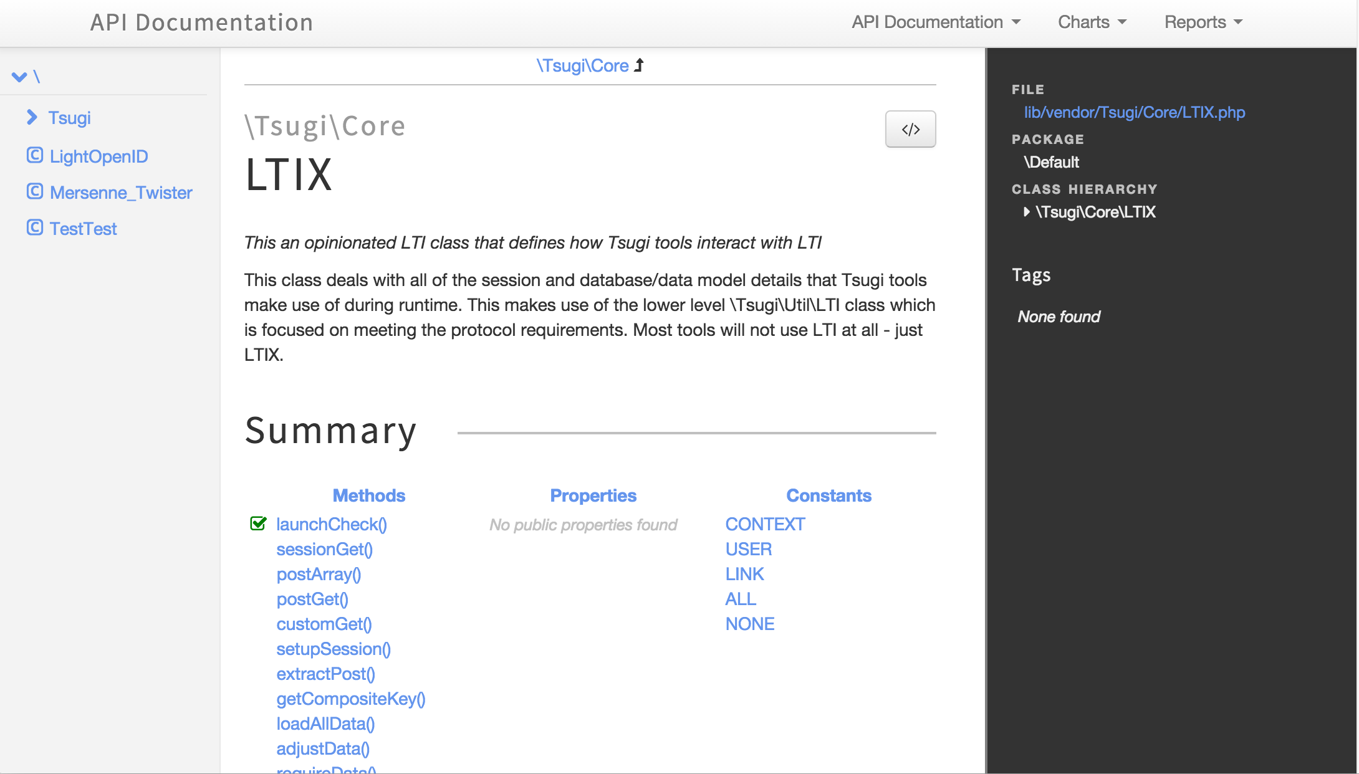
http://do1.dr-chuck.com/tsugi/phpdoc/classes/Tsugi.Core.LTIX.html

Slide 18
Tsugi Tools To Date
App Store
Google Class Map
GIFT Quiz Engine
Grade book
Attendance Tool
Video Tracker (*)
Clicker (*)
HTML5 Autograder
Python Autograder
SQL Autograder
DataMining Autograder
PHP Autograder
https://lti-tools.dr-chuck.com/tsugi Developer -> "secret"

Slide 19
Tsugi Developer Training
PHP / MySQL – www.php-intro.com
Tsugi Recorded Lecture Series
http://lectures.tsugi.org/
Lots of sample code
Assignments for Developer Workshop
Grade, Chat, Map, Wisdom of Crowds

Slide 20
Tsugi Production
Auto grading and peer grading for Coursera
pr4e.dr-chuck.com – 214353 user accounts
On campus Sakai/Canvas/Blackboard and demo accounts
lti-tools.dr-chuck.com
My own free course service
online.dr-chuck.com
Static assets on CloudFlare CDN
https://www.dr-chuck.net/tsugi

Slide 21
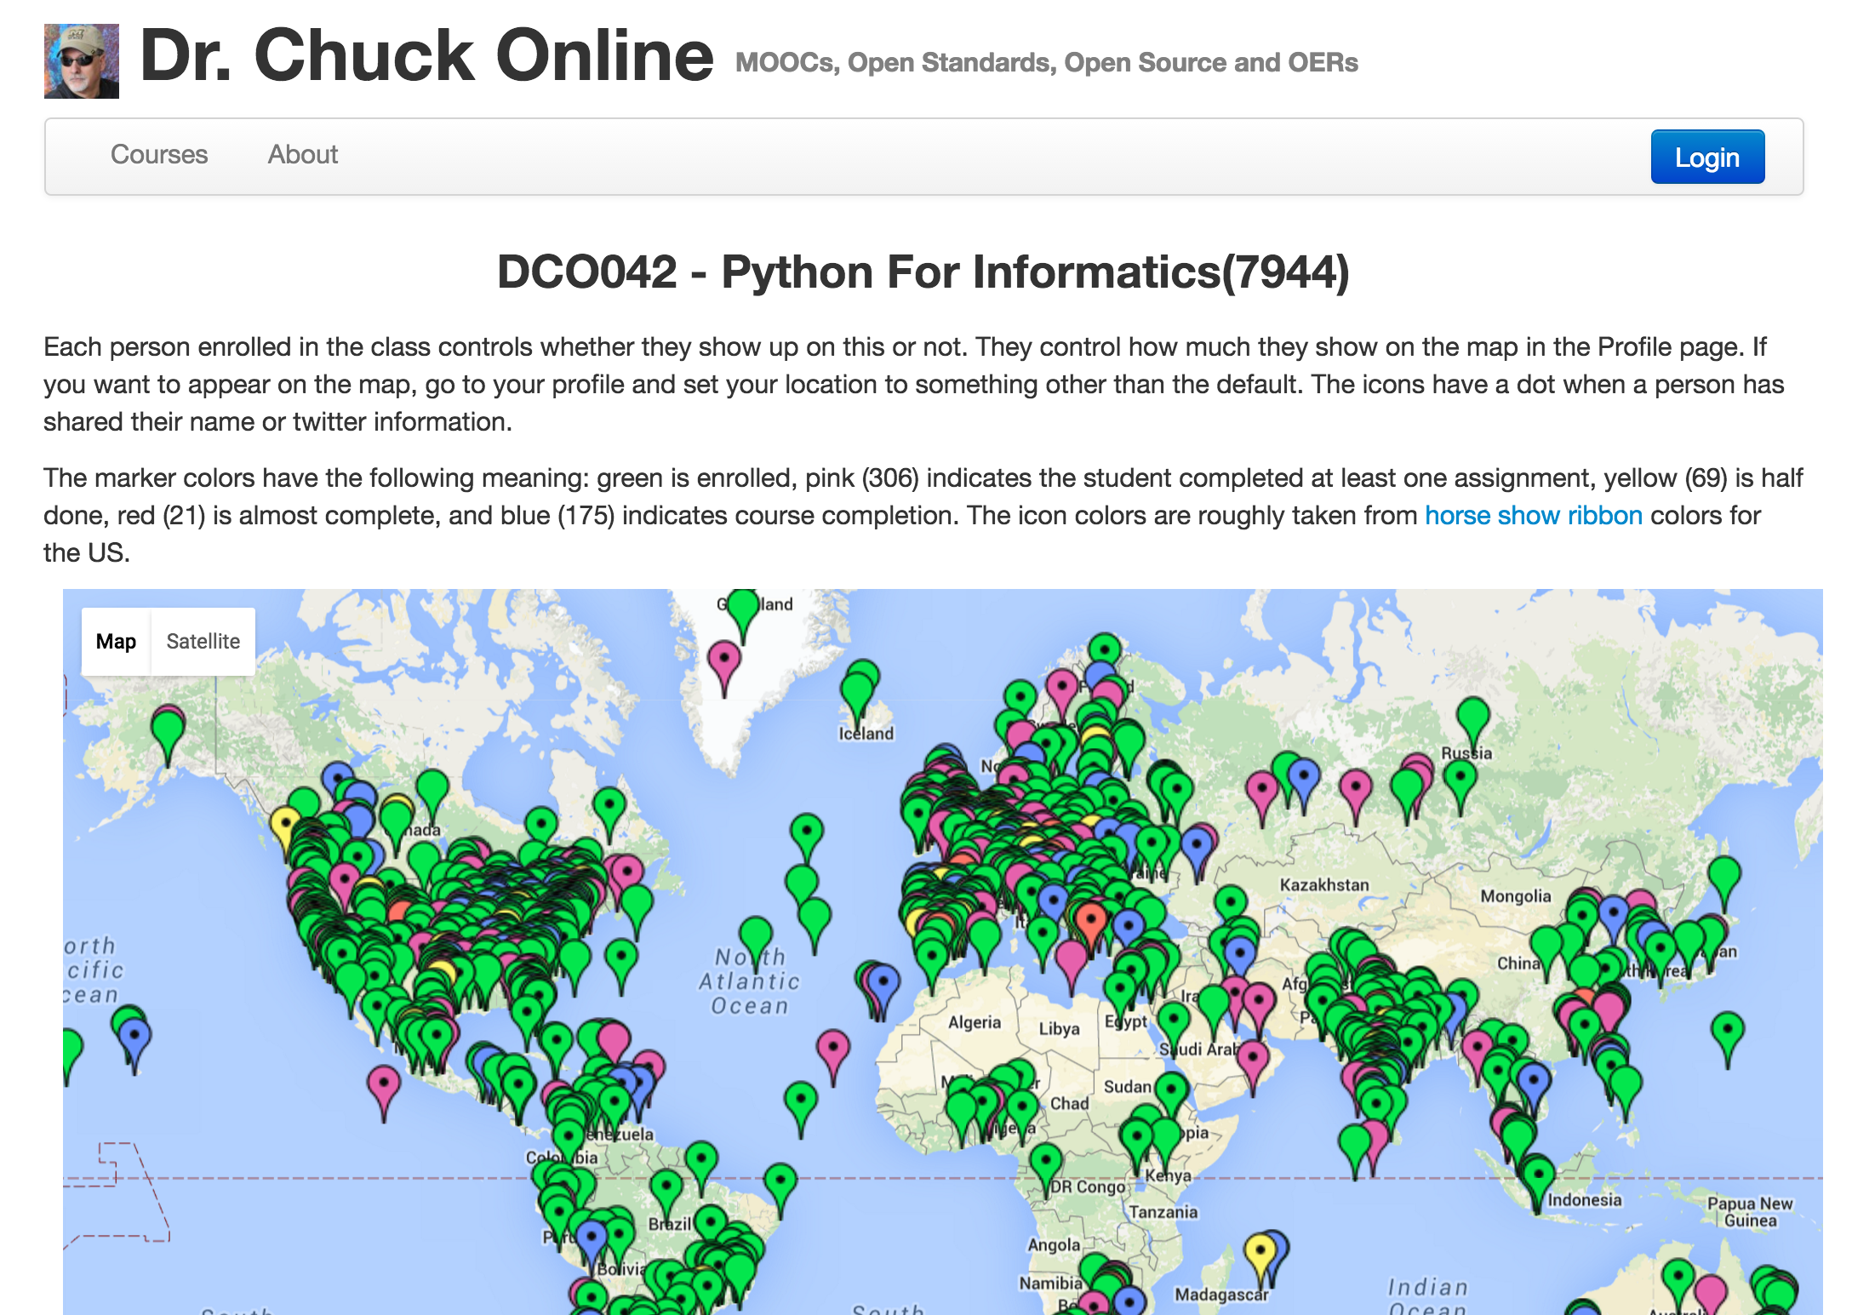

Slide 22
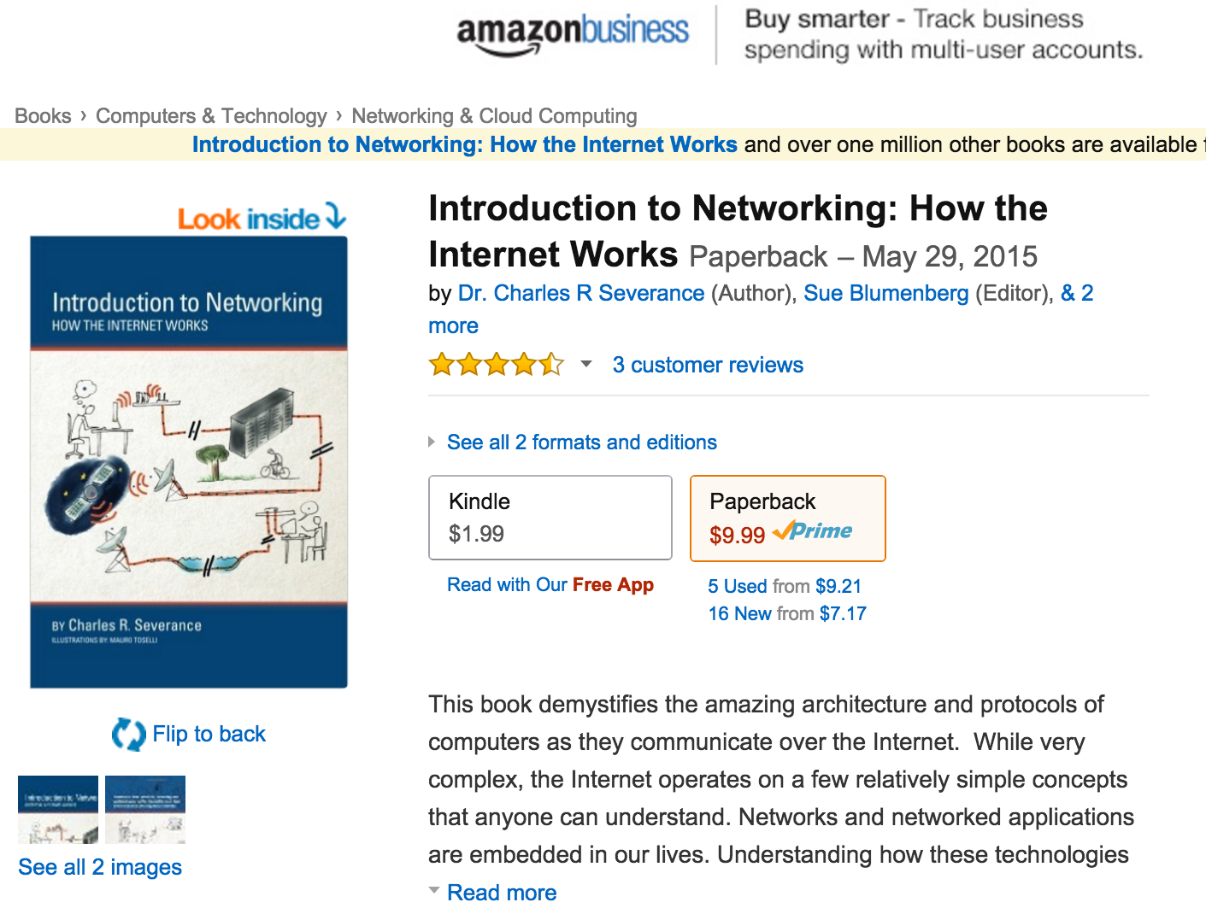
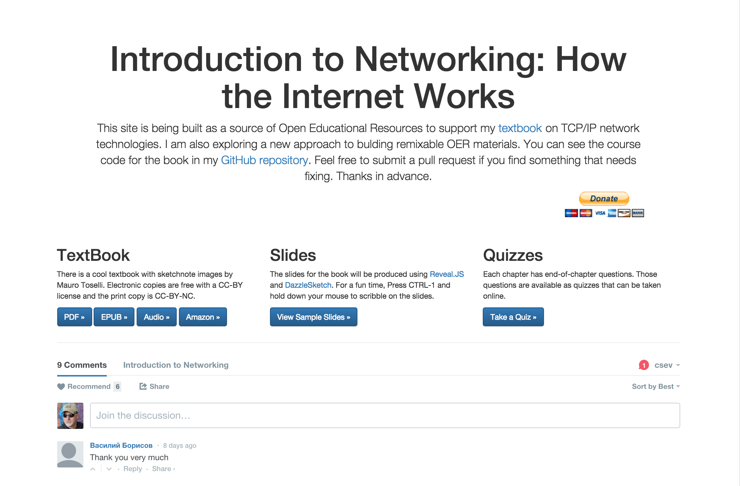
www.net-intro.com

Slide 23
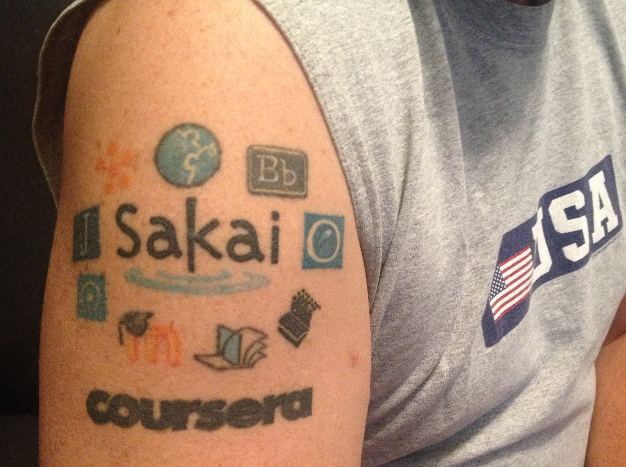
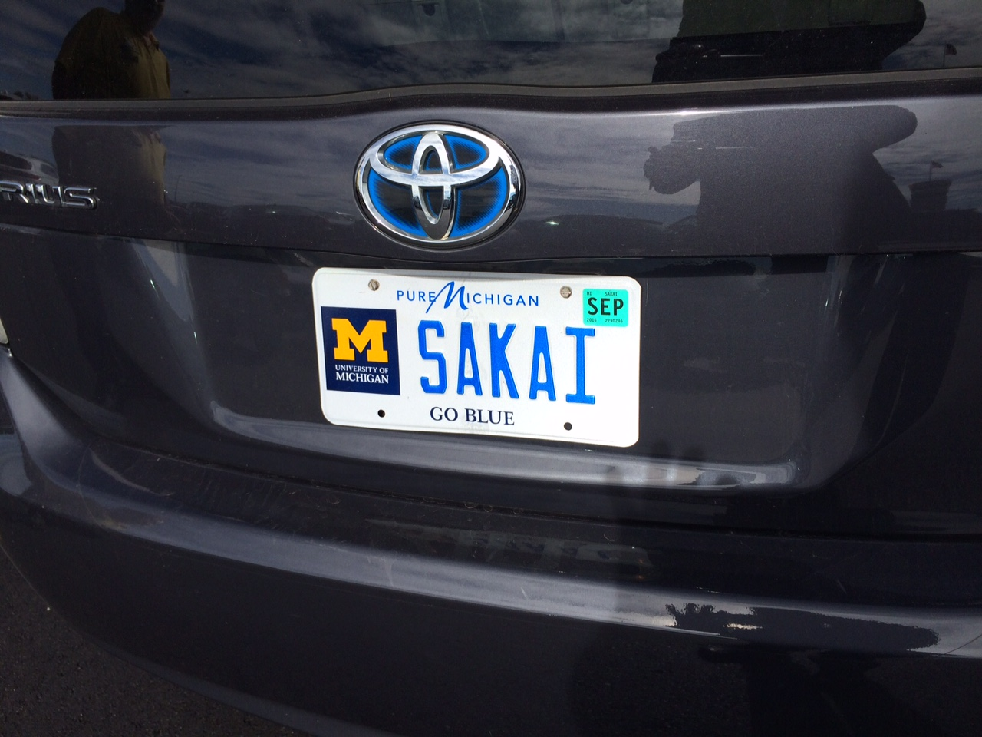
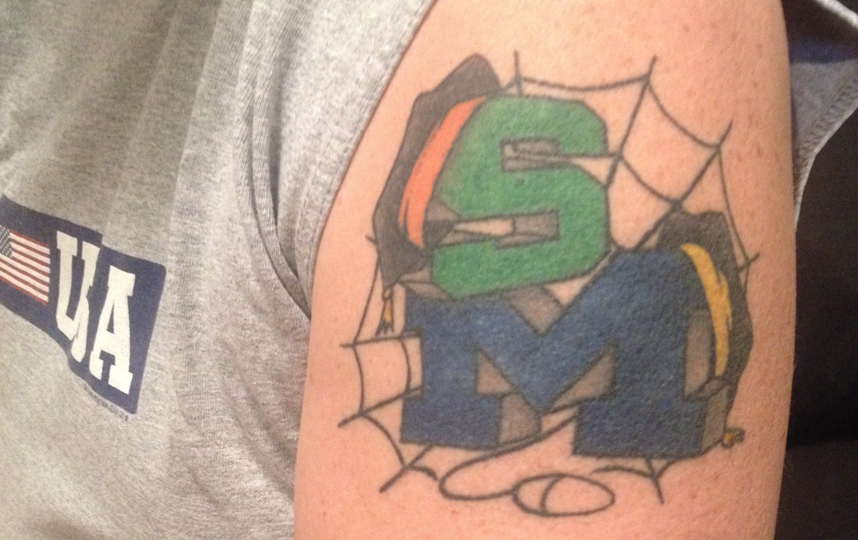
NGTL/Tsugi are early days

